Slide 1

AQUMON Robo-Advisors
Invest-it-and-forget-it investment journey
MDS 6212: Team 9
Dexin Mo Chenye Wang
Yihang Li Shuquan Yang
Yuan Liu Xiaojing Tang

Slide 2
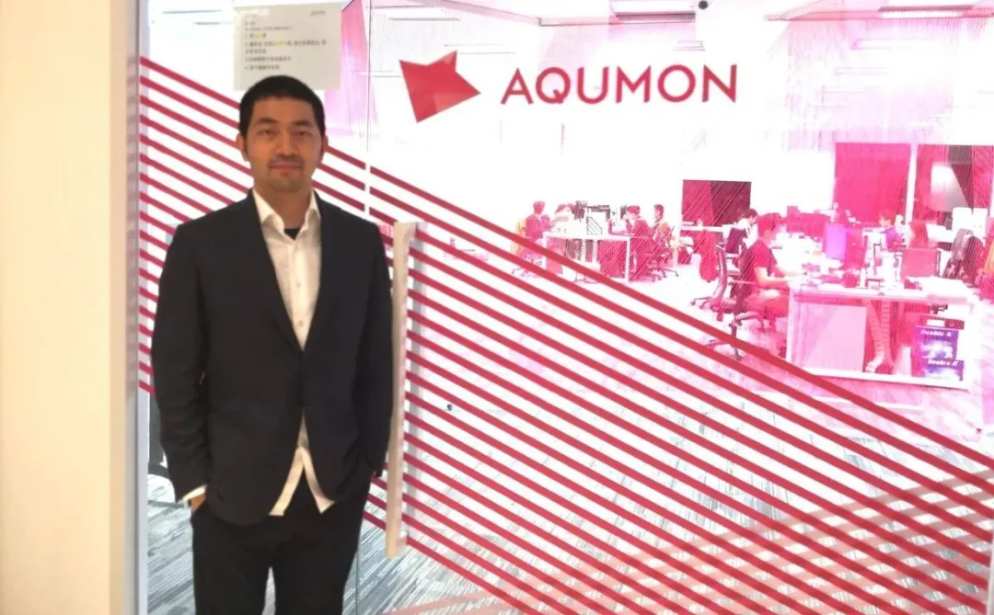



AQUMON Background
In 2016, AQUMON incubated from the Hong Kong University of Science and Technology, become a leading startup company in the financial technology industry in Asia.
AQUMON is committed to providing transparent, stable, and low-cost financial services to more institutions and retail customers through the combination of finance, algorithms and technology.
AQUMON holds the Hong Kong Securities Regulatory Commission No. 1 (securities trading), No. 4 (advising on securities), No. 9 (asset management) licenses and the U.S. Securities Regulatory Commission Registered Investment Adviser (RIA) license.

Slide 3


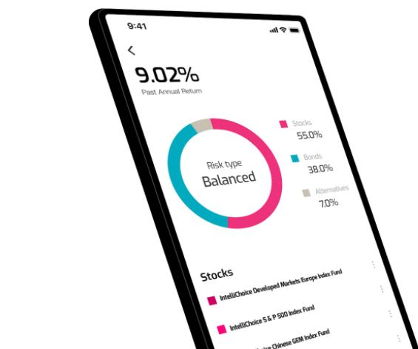
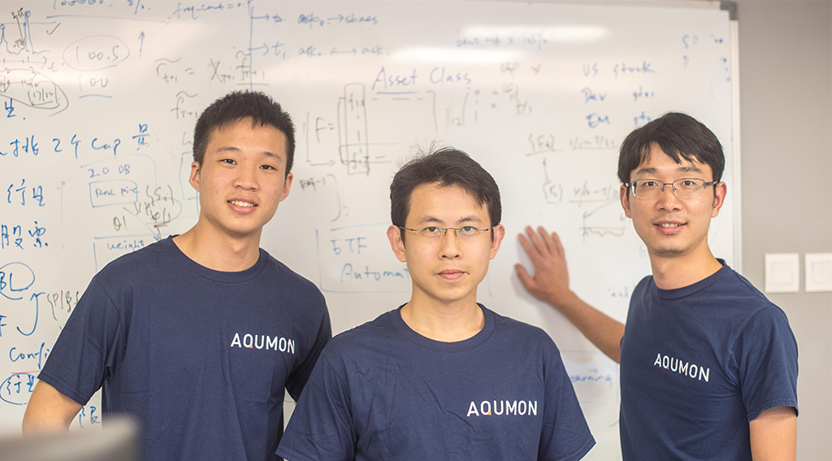
Business Model
FOHF management fee
as Robo-Advisor
Hands-on Review Portfolio
Quantitative technical support for professional investment institutions
Sales Revenue from sale of algorithms and strategies to professional investment institutions

Slide 4
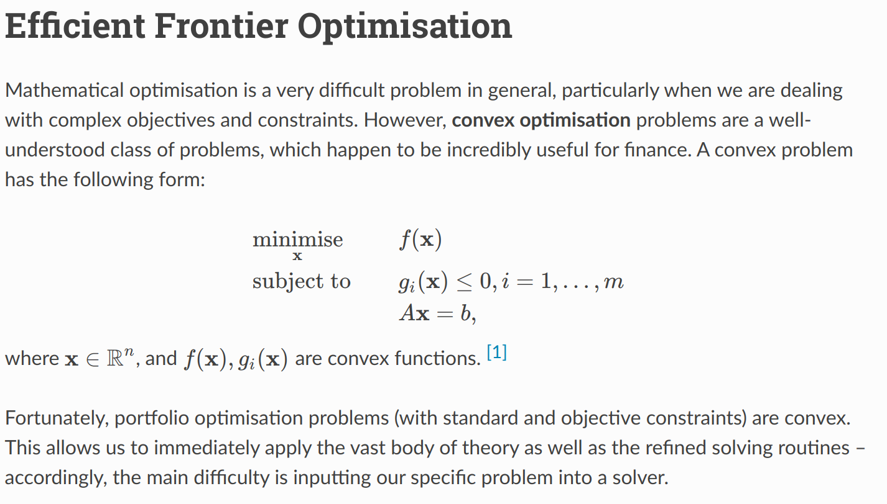
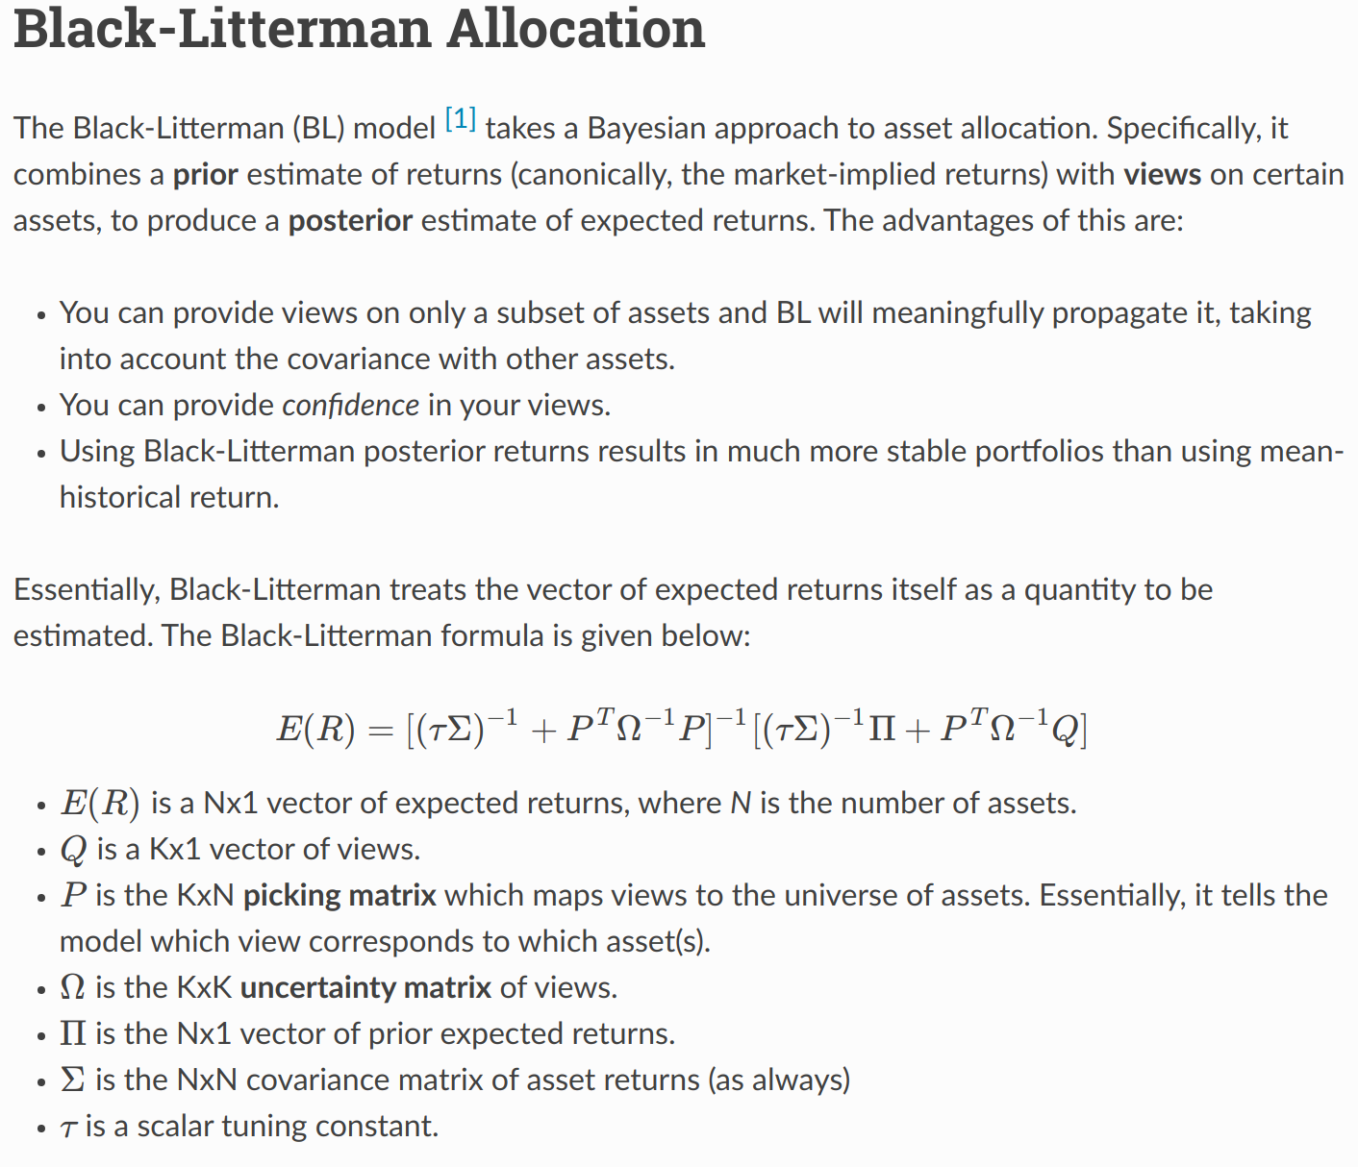
Business Model: Robo-Advisor
Efficient Frontier
Black Litterman

Slide 5
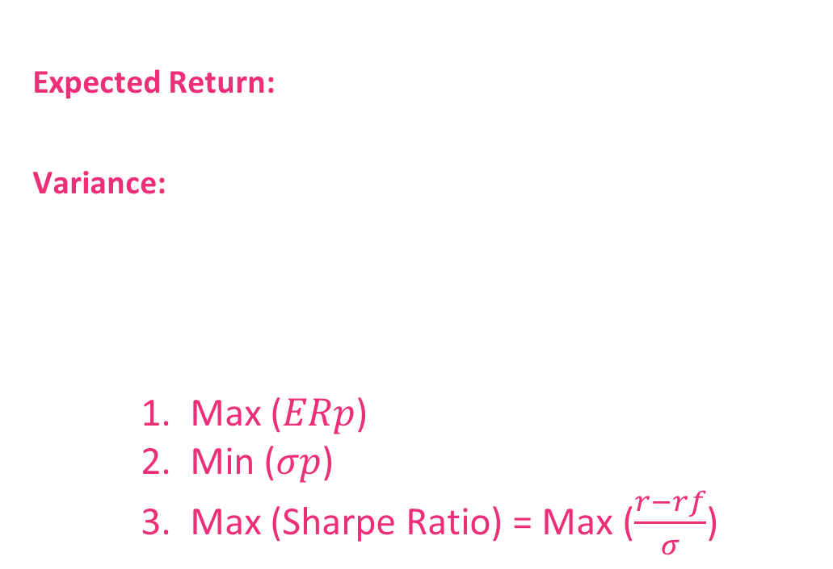
Markowitz Efficient Frontier
Mean Variance analysis of portfolio:
Expected Return:
𝐸𝑅𝑝=$∑$𝑤𝑖𝐸(𝑅𝑖)
Variance:
${σp}^{2}$= $∑ {wi}^{2}$ ${σi}^{2}$+ $∑ ∑$𝑤𝑖𝑤𝑗𝜎𝑖𝜎𝑗𝜌𝑖𝑗
Strategy:
1. Max (𝐸𝑅𝑝)
2. Min (𝜎𝑝)
3. Max (Sharpe Ratio) = Max ($\frac{r−rf}{σ}$)

Slide 6
Business Model
Black Litterman: Why improve?

Slide 7
Black Litterman: Basic idea

Slide 8
Replicate key component:
Basic assumptions
In our toy example, our universe has only Top20 (by Market Cap) S&P500 symbols. Though in real case, our base assets can be any global asset such as stocks, bonds, ETF and so on. We can do that for real case.
We use 10-Year Treasure Rate of the day 09/30/2020, which is 0.69% as our risk-free-rate. Data range to 09/30/2020.
Views: Use the annualized mean return of next two month’s return as our views. In real case, we can combine with some machine learning tectonics such as LSTM or some Time Series Prediction methods to generate our views. (absolute views)
For Back-testing, We choose the month 1, 3, 6, 9 as our rebalance months. Set start cash as 10,000, and commission rate as 0.003.
Basic Assumption

Slide 9
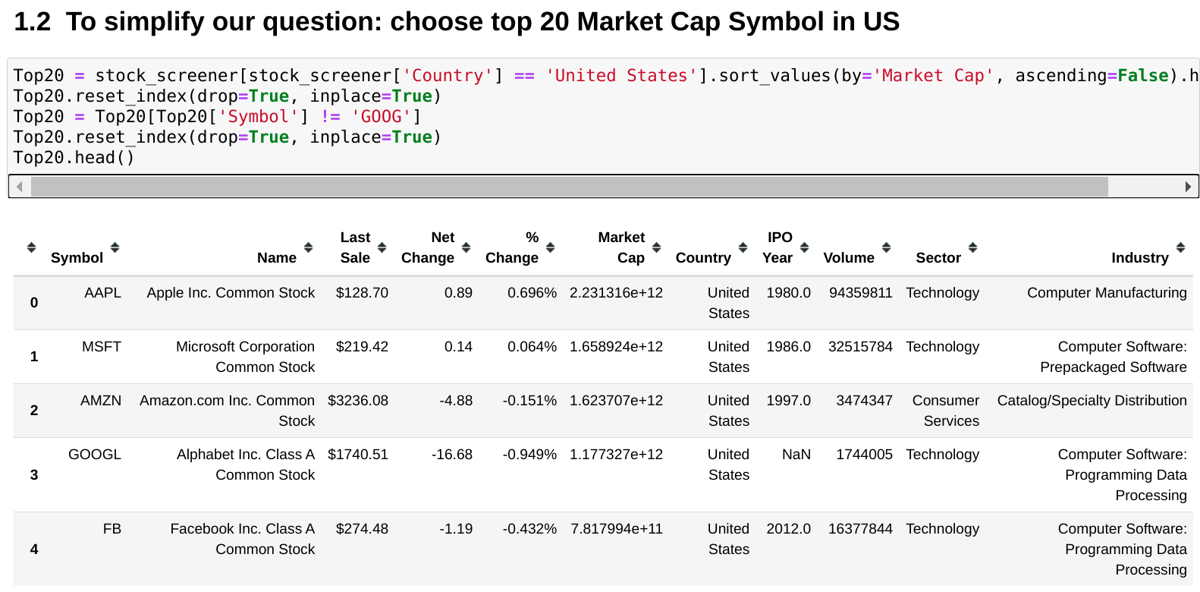
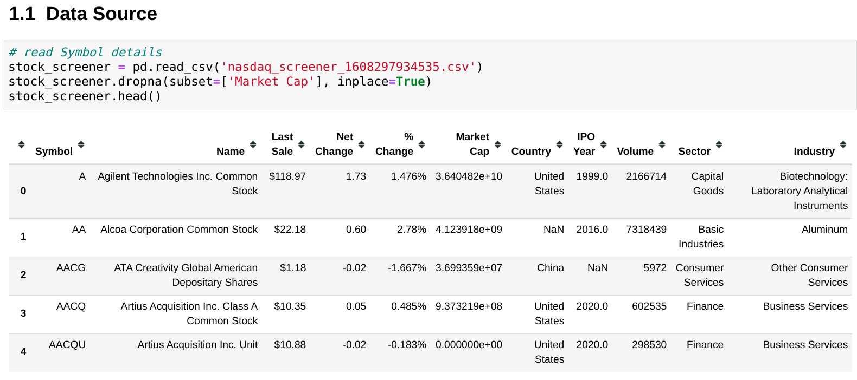
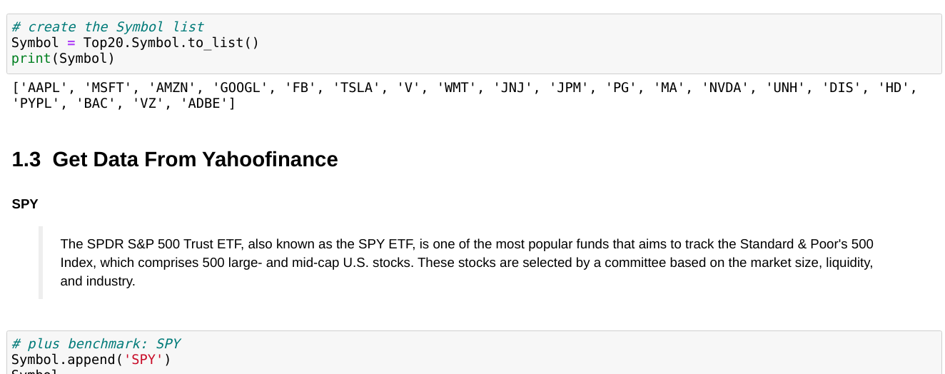
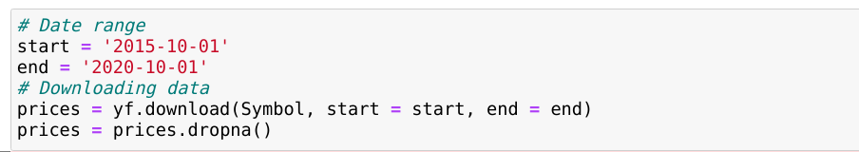
Replicate key component: Data info

Slide 10
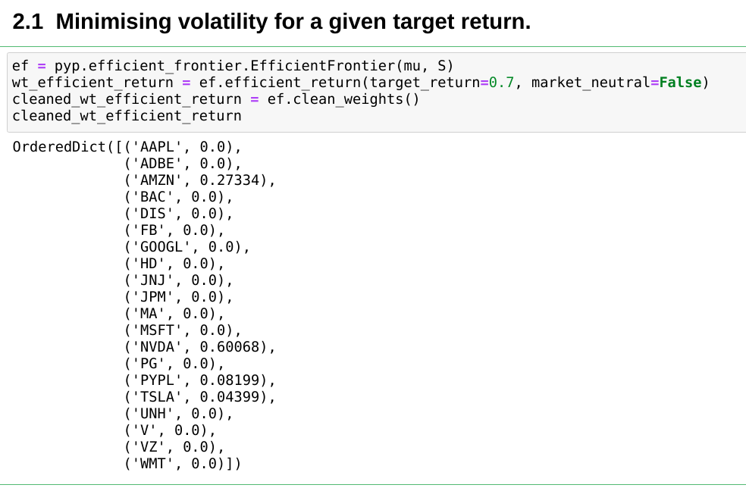
Replicate key component:
Minimising volatility for a given target return
Efficient Frontier

Slide 11
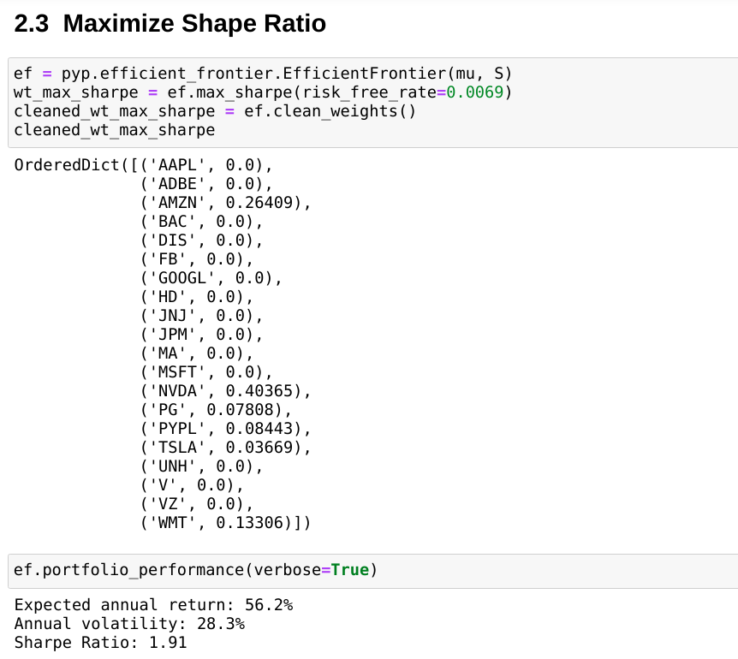
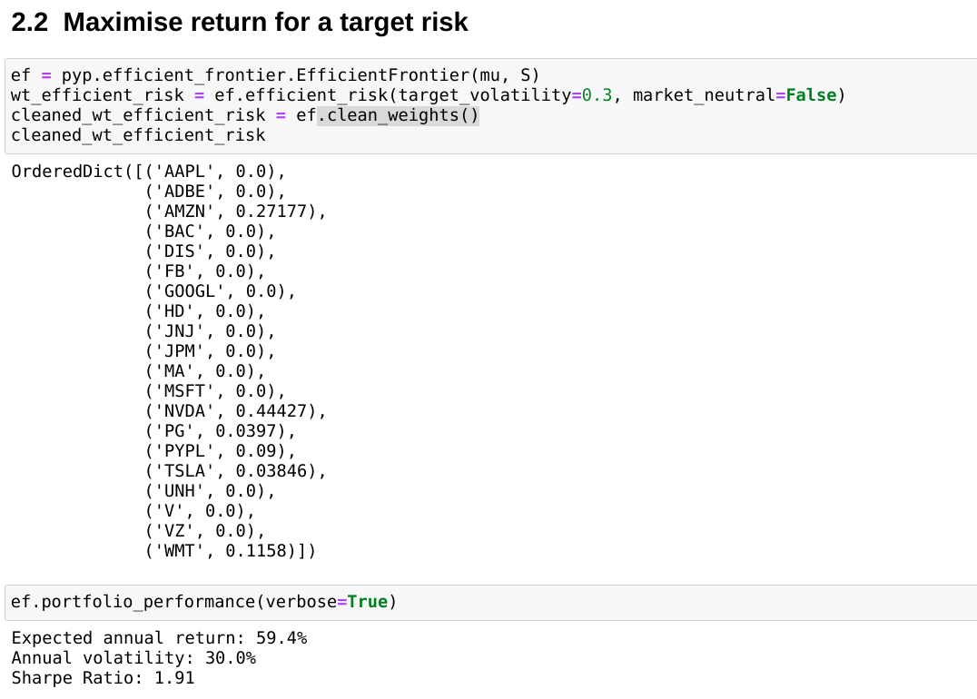
Replicate key component: Efficient Frontier
Maximize Shape Ratio
Maximizing return for a target risk

Slide 12
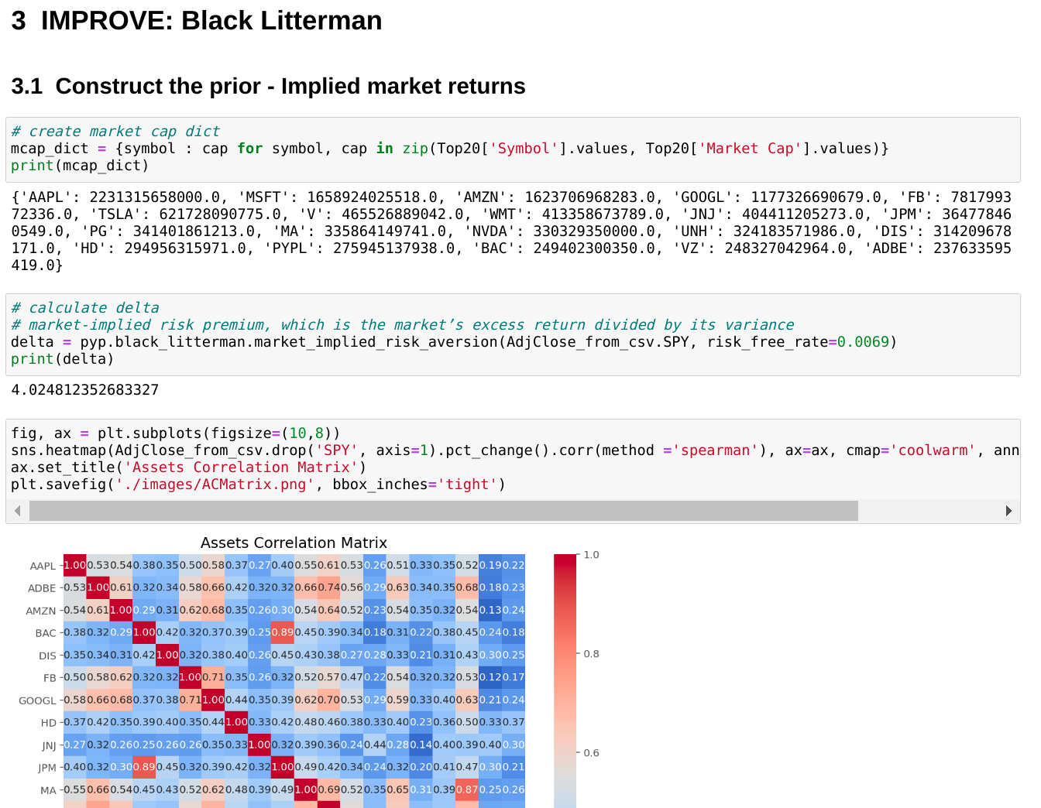
Replicate key component:
Black Litterman Construct Prior and views

Slide 13
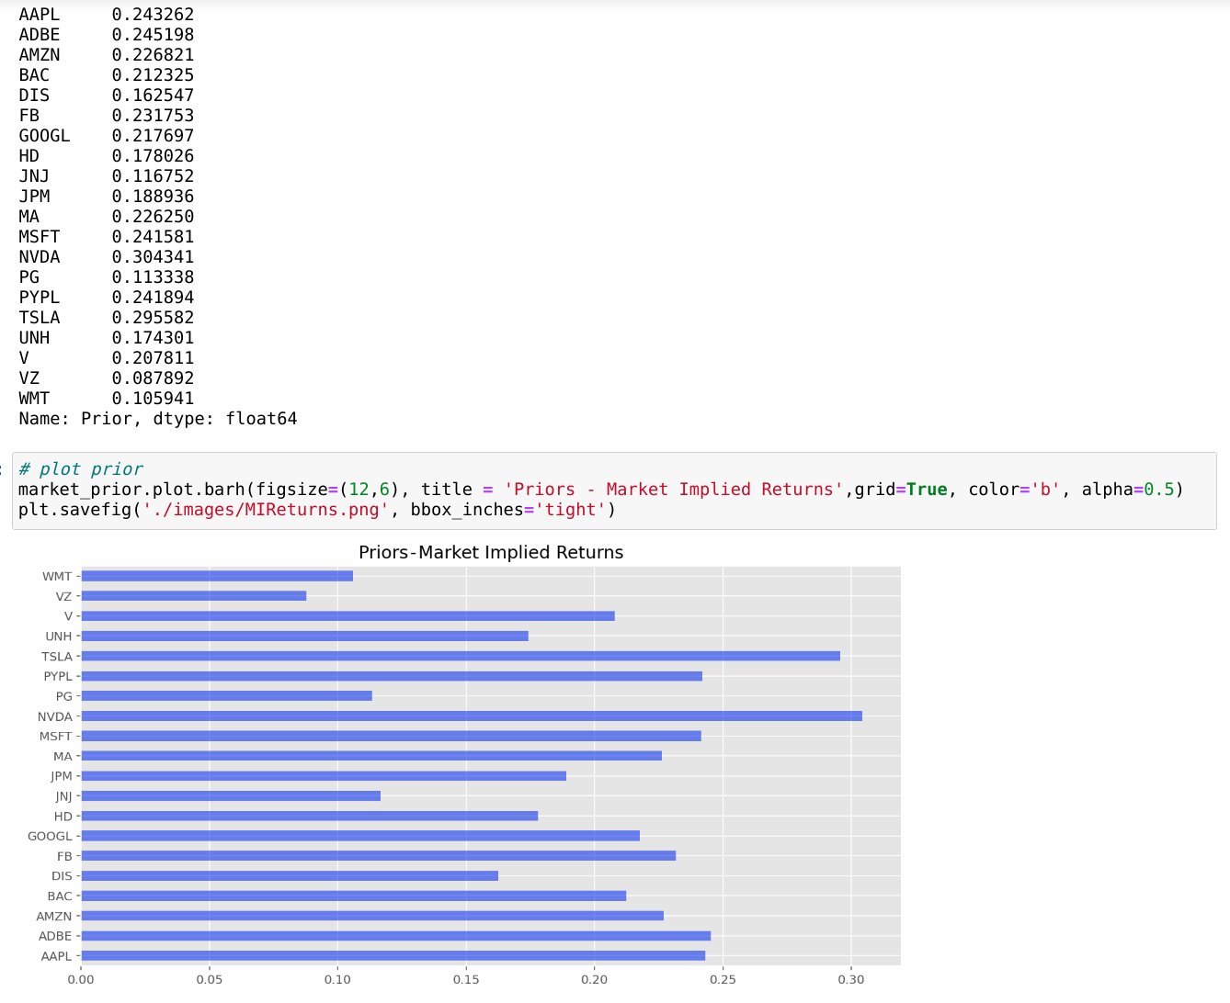
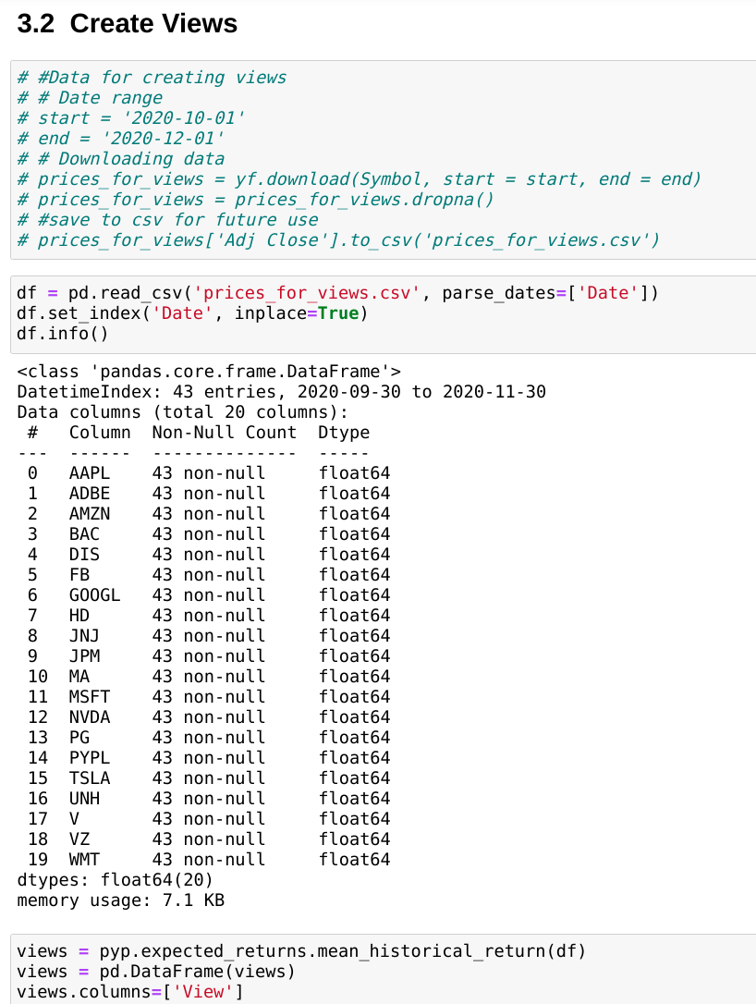
Replicate key component:
Black Litterman Construct Prior and views

Slide 14
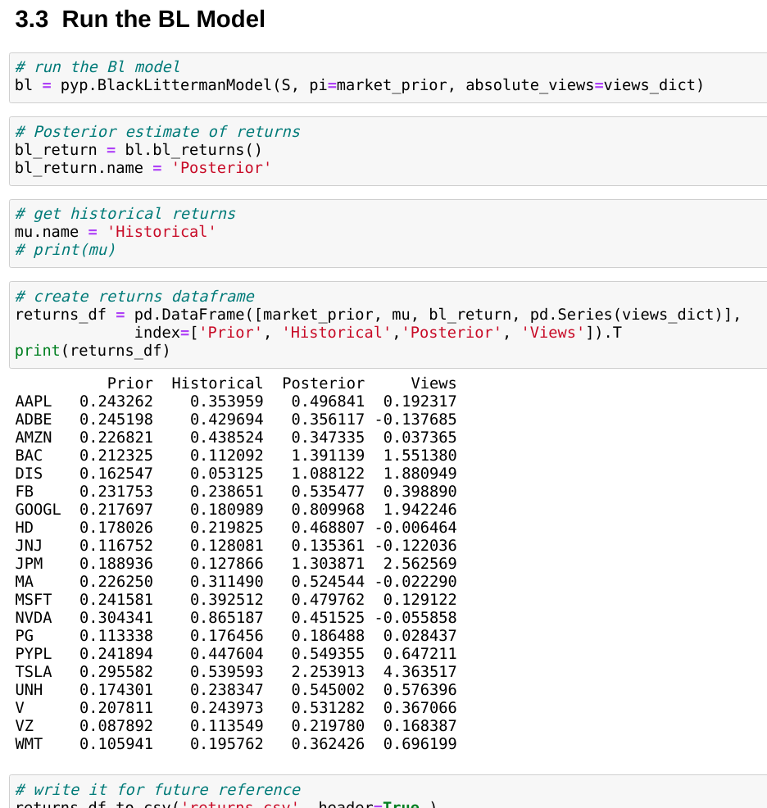
Replicate key component:
Black Litterman Construct Prior and views

Slide 15
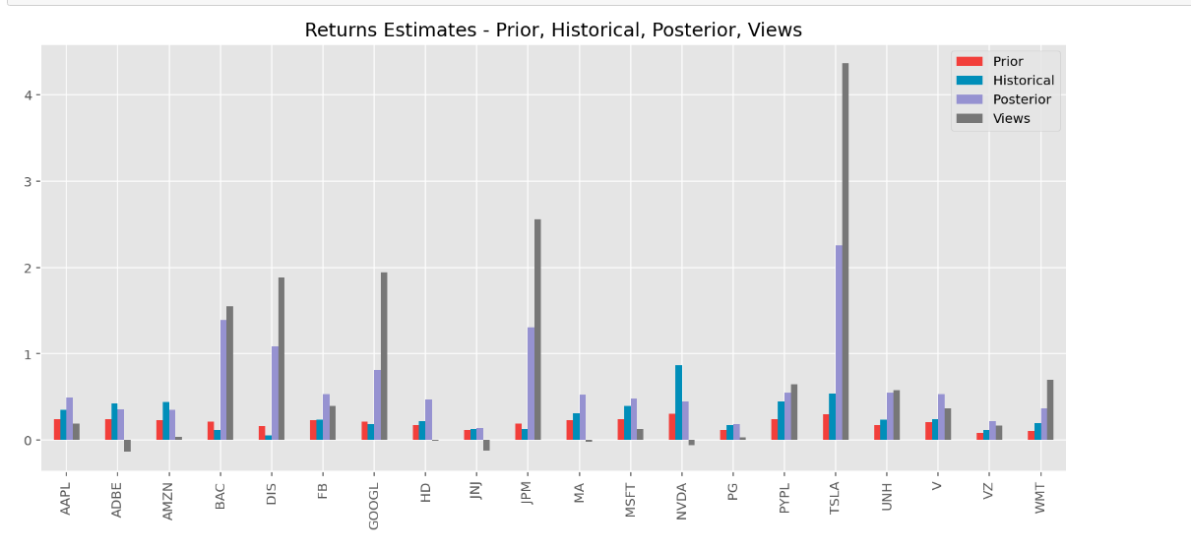
Replicate key component:
Black Litterman Construct Prior and views

Slide 16
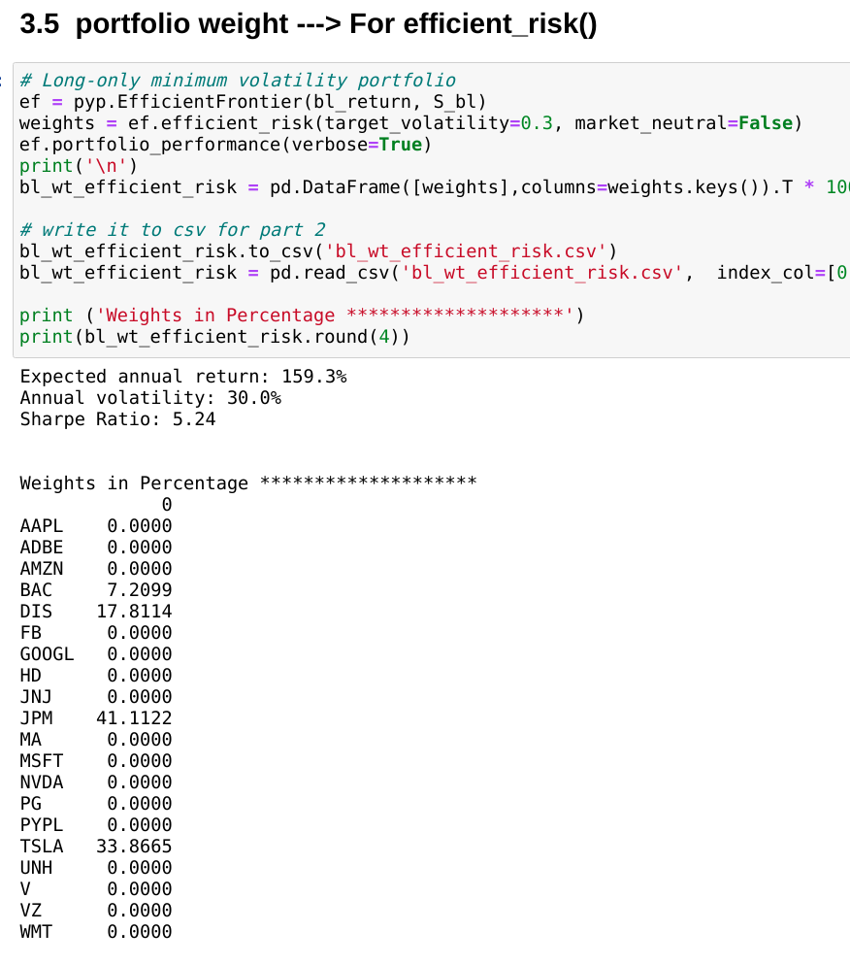
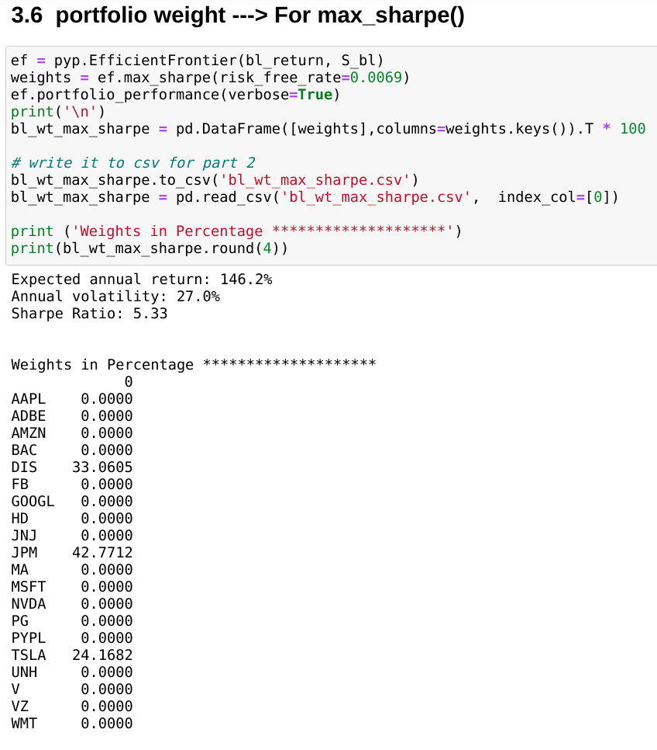
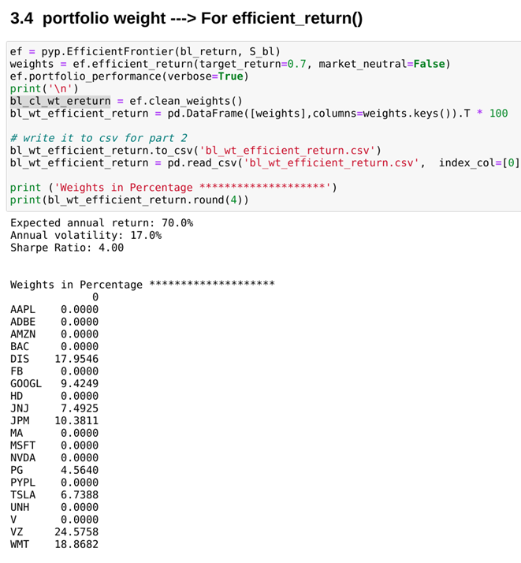
Replicate key component:
Black Litterman + Efficient Frontier

Slide 17
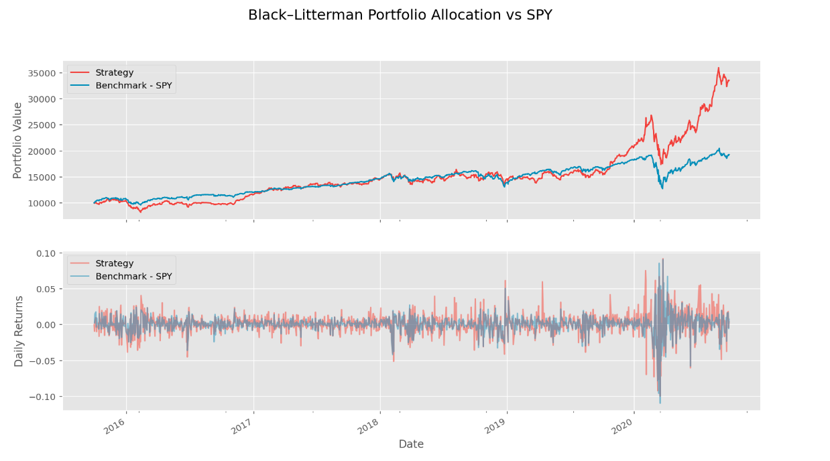
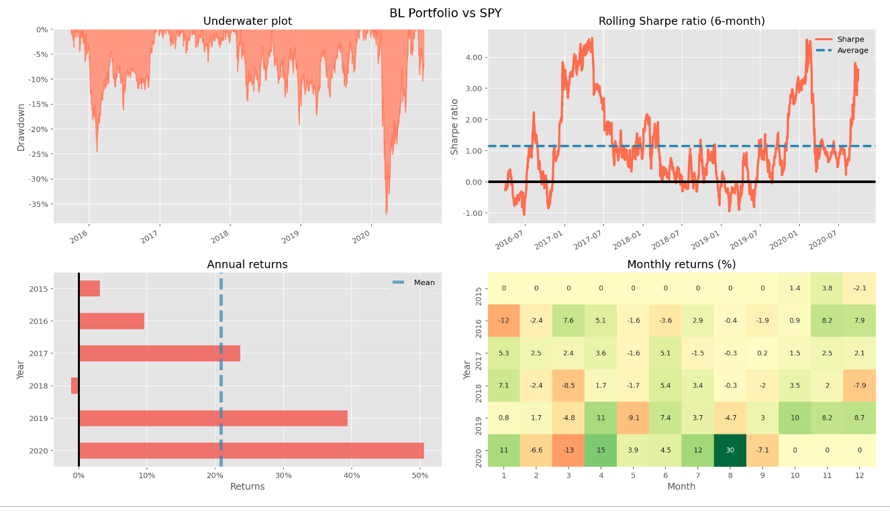
BackTesting:
Take Black Litterman + MaxSharpe for example

Slide 18
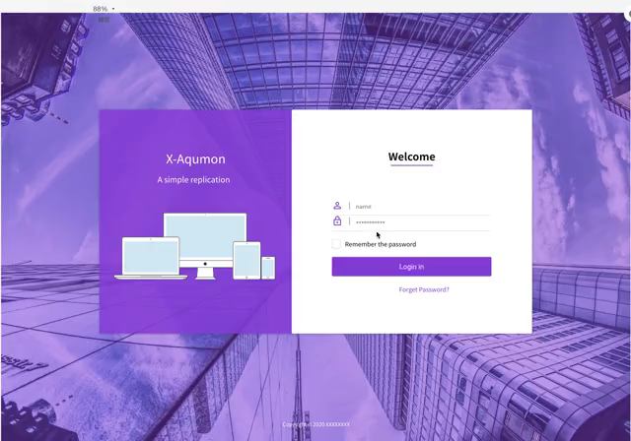
WebPage Display

Slide 19
Our Future Work

Slide 20
AQUMON Robo-Advisors
MDS 6212: Team 9
Thank you for your attention.

Slide 21
Q & A
This document is for informational purposes only. This document does not constitute an offer to sell or a solicitation of any offer to invest. The information contained in this document does not purport to be complete nor accurate.
This document may not be reproduced or distributed without the written authorization of Magnum Research Limited. Any reproduction or distribution of any of the contents of this document may constitute a violation of law. By accepting this document, you acknowledge and agree that all of the information contained in it shall be kept strictly confidential.
Certain information contained in this document includes observations and assumptions and involves significant elements of subjective judgement and analysis. No representations are made as to the accuracy of such observations and assumptions and there can be no assurances that actual events will not differ materially from those assumed. Additionally, the selection and determination of the duration of the market cycles included in this document involved subjective judgement.

